Slide 1
Metro Interstate Traffic Volume Data Analysis
Presenter: Suchismita Moharana
Notes:
Hi Everyone, This is Suchismita. Welcome back! I am really excited to have you all here today with me again.

Slide 2
Introduction
Time is important to everyone and hence in Today’s world, everyone wants to utilize their time wisely. We will discuss about how predicting road traffic volume will help us in saving time on road when we travel during busy hours.
Notes:
We discussed last time about the analysis that am doing on traffic volume data. So, we will skip introduction here.

Slide 3
Data Source
For our analysis, we have collected this data (which is publicly available) from http://archive.ics.uci.edu/ml/datasets/Metro+Interstate+Traffic+Volume
This analysis will help in better urban planning, maintenance planning, lowering congestion level and increasing driver safety by forecasting the traffic volume for a future timeframe.
Notes:
And we will skip data source details page. But lets talk about the new details that we saw in data last time after we spoke.

Slide 4
Comparison of different trend in all type of timeframe
Hourly Traffic Trend
Weekly Traffic Trend
Monthly Traffic Trend
From the above graph, you can see that traffic is strongly dependent on hour of day.
Similar to hourly data, traffic is dependent on day of week.
Similarly, pattern seem to exist in monthly data and we can see that people tend to travel more in summers than winters.
Notes:
Now we can compare different traffic pattern we saw in different time component.

Slide 5
Stationary / Non-Stationary
From spectral density we can see that data has a cycle of 24 and has cycle of 12. Here based on our analysis, we believe this is non-stationary model.
Notes:
Let's talk little more about ACF here. As you can see ACFs are exponentially damping with sinusoidal pattern. We talked about spectral density last time already and about the peaks that we see here. We see from the Spectral densities plot that there exist seasonal trend in the data.
We see seasonality of 24, 12, 7 in the data. So, data is not independent of time. Daily mean, weekly mean can vary over time based on month of the year. Hence, this model is non-stationary.

Slide 6

ARMA (5,1) model for our data
We found ARMA(5,1) as best fit by AIC estimate function with a lowest AIC of 13.04.
ASE : 2475821
We can represent it as below.
(1 - 2.10 B + 1.46 B² - 0.27 B³ - 0.12 B⁴ + 0.08 B⁵) (X_{t} - 3259.8) = a_{t} - 0.78 a_{t-1} , $σa2$ = 461318.1
Notes:
We talked about ARA(5,1) model for our data that we had fit last time based on initial assumption of stationary data. But since we saw seasonal component, so lets analyse the data by applying seasonal model.

Slide 7
Seasonal model for our data
From the spectral density plot and the basic EDA, we saw that the traffic volume is heavily dependent on hour of the day. So, we decided to use a seasonality factor of 24 in our model.
But first let’s analyze if the trend really is statistically significant which we saw in EDA.

Slide 8
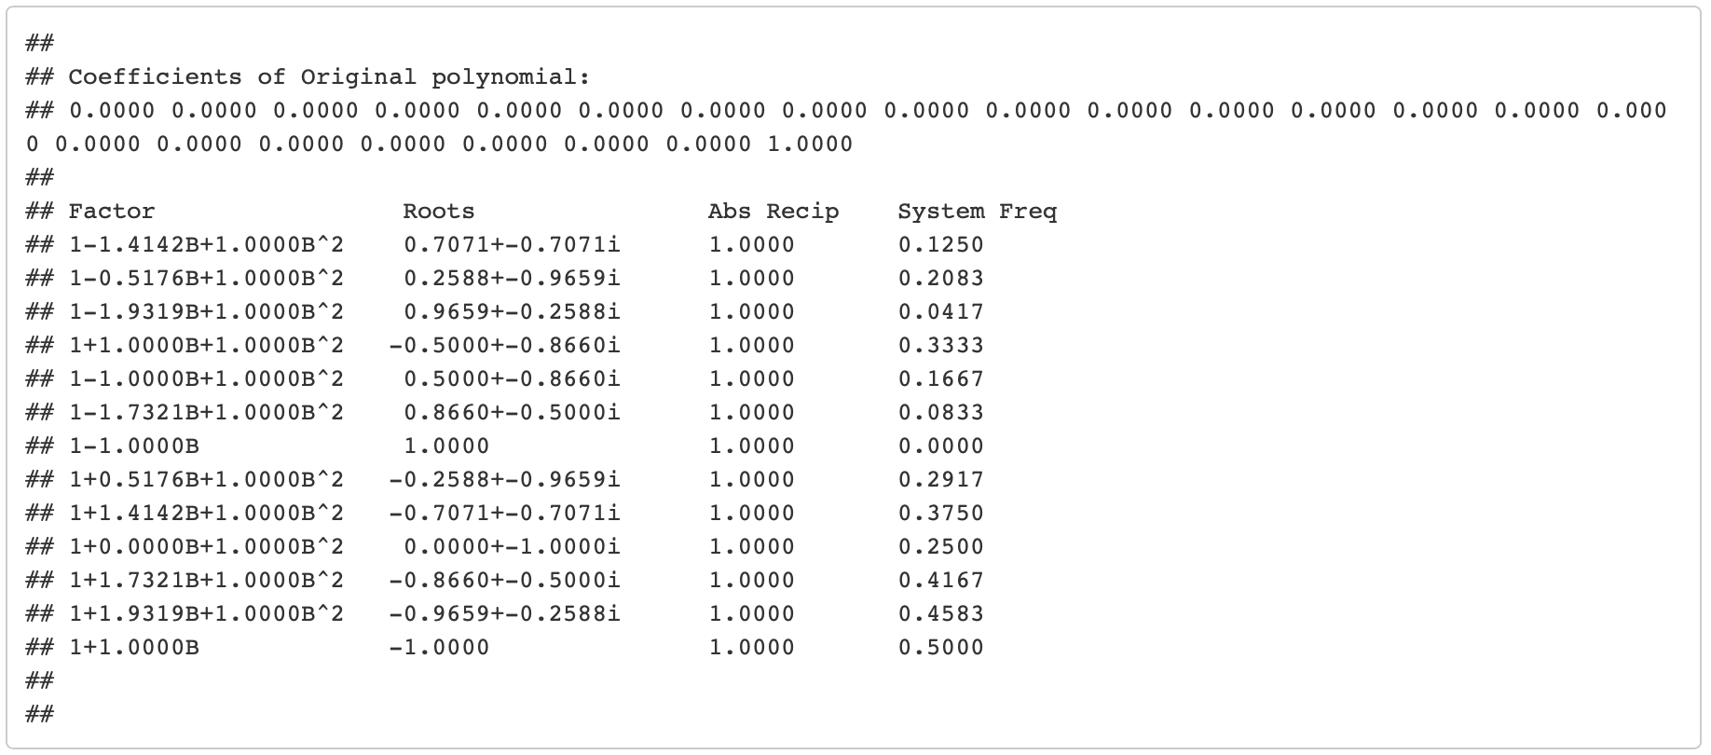
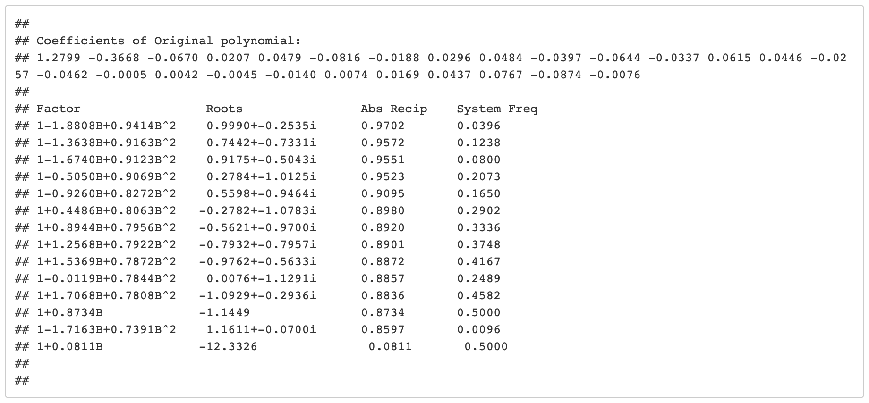
Seasonal model for our data contd.. (Factor table comparison)
Original Factor Table
Data Factor Table (after overfitting)

Slide 9
Seasonal model for our data contd..
From factor table comparison, we are confident that we can go ahead and apply a seasonality of 24 while forecasting.
The ASE (2888406) of this model came out to be little higher than our stationary ARMA model.
While fitting seasonal model, we found the ARMA component to be as (3,1) as per AIC estimate.
But when we did fit the model with previously diagnosed ARMA (5,1) with a seasonal factor of 24, we got lower ASE. Hence, we decided to use this.

Slide 10
Seasonal model for our data contd.. Actual vs Forecasted(Red)

Slide 11
Seasonal model for our data contd..
Even though the ASE estimate of ARMA(5,1) model is lowest (compared to our other models), we will not pick this model as our final model as we know this is not taking the seasonality into consideration.
From our analysis, we saw that there exist strong repetitive behavior every 24 hours. Also, we saw that the traffic volume at weekdays are significantly different than weekends.
So, we decided to build a model that will help in predicting hourly traffic for weekdays which is going to help others while commuting for work.

Slide 12
Final Short Term Forecast Actual vs Forecasted(Red)

Slide 13
Final Long Term forecast

Slide 14
Conclusion
Based on our short term forecast, it would be easier for navigation companies to show predicted traffic on road to end users.
Our long term forecasts will help in congestion planning on highways. However, it needs more analysis as we need to take monthly trend into consideration as well which we have seen in data.

Slide 15
Thank You!
Presenter: Suchismita Moharana

